Slide 1
JBOSS EAP 7.3 – Directory structure explained

Slide 2
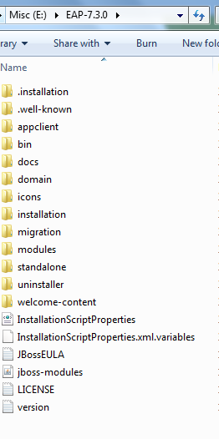

Slide 3
Directory structure
Directory | Description
appclient | Configuration files, deployment content, and writable areas used by the application client container.
bin | Startup scripts (.bat, .sh files), startup configuration files, and various command line utilities like vault, add-user, and Java diagnostic report available for different environments
docs/schema | The XML schema definition files.
docs/examples/config | Example configuration files representing specific use cases.
domain | Configuration files, deployment content and writable areas used when running in the domain mode
icons
installation
migration
modules | JBoss EAP is based on a modular class loading architecture. The various modules used in the server are stored here.
standalone | Configuration files, deployment content and writable areas used in the standalone mode
welcome-content | Default welcome page content.

Slide 4
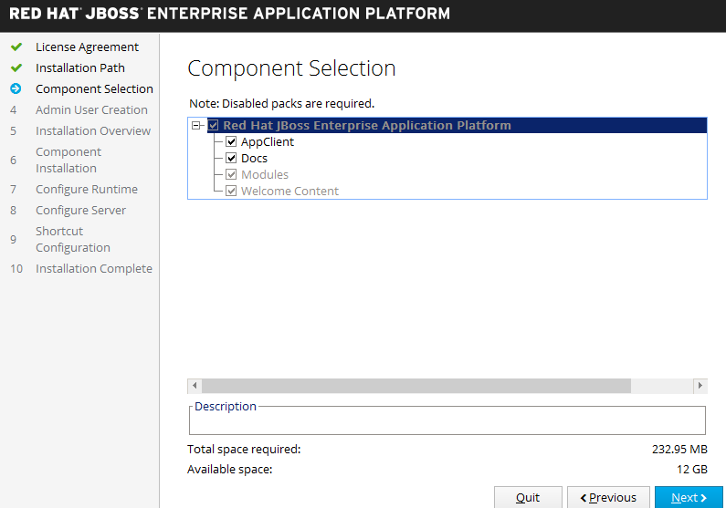

Slide 5
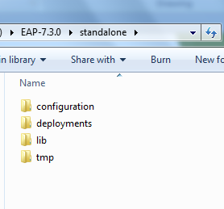

Slide 6
Standalone Directory Structure
A JBoss EAP standalone server instance is an independent process. The configuration files, deployment content and writable areas used by the standalone server are found in the following subdirectories under the top level standalone directory:
Directory | Description
configuration | Configuration files for the standalone server. All configuration information for a server is located here and this is the single place for configuration modifications for the standalone server.
data | The directory used for persistent data file storage.
lib/ext | The directory for installed library JARs referenced by applications using the Extension-List mechanism.
log | The default directory for log files.
deployments | End user deployment content can be placed in this directory for automatic detection and deployment of that content into the server's runtime.
tmp | The default directory for temporary files written by the server
tmp/auth | Special directory used to exchange authentication tokens with local clients so they can confirm that they are local to the running server's process.

Slide 7
Using System Properties
Some of the default directories for a JBoss EAP standalone server can be overwritten with system properties.
These system properties must be passed to the start script or placed in the standalone.conf (loaded from standalone.sh) or standalone.bat.conf (loaded from standalone.bat) files.
The following table shows the directories that can be overridden.
System Property | Description | Default Value
java.ext.dirs | The JDK extension directory paths. | null
jboss.home.dir | The root installation directory for JBoss EAP. | JBOSS_HOME environment variable set by the startup script.
jboss.server.base.dir | The base directory for the server. This directory contains all the directories defined in the standalone directory structure. | %jboss.home.dir%/standalone
jboss.server.config.dir | The directory that contains the configuration files. | ${jboss.server.base.dir}/config.

Slide 8
Using System Properties – Contd..
jboss.server.data.dir | The directory used for persistent data file storage. | ${jboss.server.base.dir}/data
jboss.server.content.dir | The directory used to store content managed by the server. | ${jboss.server.base.dir}/content
jboss.server.log.dir | The default directory where logs are stored. | ${jboss.server.base.dir}/log.
jboss.server.temp.dir | The directory used for temporary file storage. | ${jboss.server.base.dir}/tmp

Slide 9
Security Realm – Management Realm and Application Realm
Security realms are a mechanism for adding authentication and authorization applications.
JBoss provides two security realms by default:
ManagementRealm
stores user, password, and role information for the Management API, which provides the functionality for the Management CLI and web-based Management Console.
ApplicationRealm
stores user, password, and role information for Web Applications and EJBs.
Each realm is stored in two files on the filesystem:
REALM-users.properties stores usernames and hashed passwords.
REALM-users.roles stores user-to-role mappings.
The properties files are stored in the domain/configuration/ and standalone/configuration/ directories.

Slide 10
Reference
https://access.redhat.com/documentation/en-us/red_hat_jboss_enterprise_application_platform/7.3/
https://access.redhat.com/documentation/en-us/red_hat_jboss_enterprise_application_platform/7.3/html/configuration_guide/index

